Slide 1


Lesson: 01 Linux Distributions and Red Hat
azaj.ikbal

Slide 2
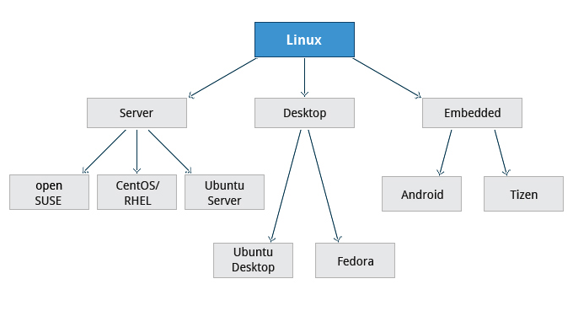
Linux OS Types

Slide 3

Choosing a Linux Distribution

Slide 4
What Exactly is a Linux Distribution?
There is always a Linux Kernel (the core component of the Linux OS)
The default GNU software (tools like bash, gcc, gawk, grep etc.)
General software to be expected of a Linux distribution (text editors)
Installation Software: For installing software, or the operating system
General software: (Office Apps, Prog. Languages, Games, Web Software)
Update and Patches: (buggy or not buggy software, latest versions )
Support: Whether the distributor offers a good channel of support or not
Platform: User friendly, Graphical interface, Server OS, Supercomputer OS
Cost – whether you pay nothing, a little, or a lot for a distribution depends
on what you need from it and the business model the distributor works to.
How easy it is to use overall.

Slide 5



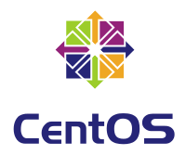





What Linux Distribution should I choose?
Choosing a Linux distribution is a personal thing. It greatly depends on what you want to do with it.
Beginner to Advanced/Server
Beginner to Advanced/Server
Intermediate to Advanced/Server
Intermediate to Advanced/Server

Slide 6


About Red Hat
Red Hat, Inc., founded in 1993, assembled an OS called Red hat Linux (RHL)
First Version a Red Hat Linux 1.0 in November 1994
Last version of this series, called Red Hat Linux 9 based on 2.4.20 kernel
Red Hat renamed the RHL to RHEL (Red Hat Enterprise Linux) in 2003
In 2003, Red Hat Began sponsoring a project called Fedora
The Fedora distribution is completely free; RHEL is commercial
Red Hat released new distribution (RHEL5/RHEL6/RHEL7) every 3 to 4 years
New update/version released every 6 months

Slide 7
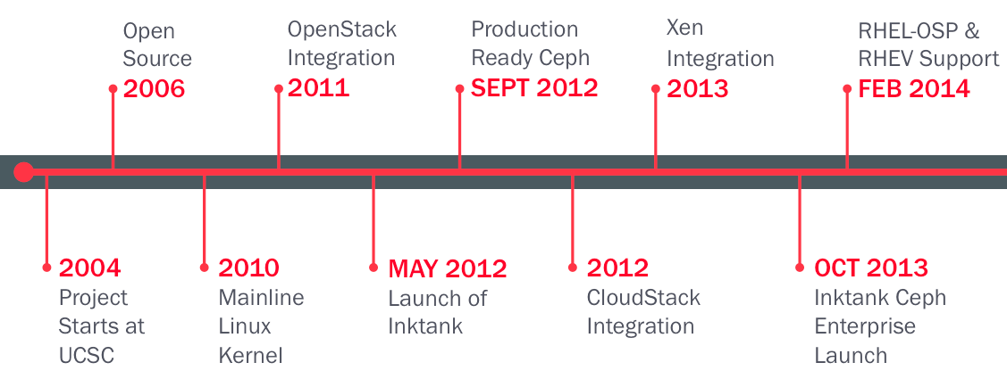
Red Hat Linux Distribution Road Map
RHL 1.0 & 2.0
1995
RHEL 2.1
2001
RHL 9.0/RHEL 3.0
2003
RHEL 5.0
2007
RHEL 7
2014
Founded
1993
RHL 7.0
2000
RHL 8.0
2002
RHEL 4.0
2005
RHEL 6.0
2010

Slide 8
Red Hat Linux Distribution Platforms
Red Hat Enterprise Linux for Desktop
Red Hat Enterprise Linux for Workstation
Red Hat Enterprise Linux for Server
Red Hat Enterprise Linux for IBM Power
Red Hat Enterprise Linux for IBM System z
Red Hat Enterprise Linux for Virtual Datacenters
Red Hat Enterprise Linux for SAP Business Applications
https://www.redhat.com/en/store/linux-platforms

Slide 9
Why Red Hat Enterprise Linux
Reputed Certification in Industries
Widely Used on Servers/Workstation/PowerPC
Lots of enterprise level features (cluster, storage, datacenter)
High level security (SELinux, Firewalld, IPS/IDS)
Different level technical support to end user
On demand business/application based customization OS
On demand custom application features (file systems, application)
Continues update/patches and released
10 years service/support for each version/released
Supported IBM Power/Mainframe platform
Virtual Datacenter Design (Red Hat Virtualization platform)

Slide 10
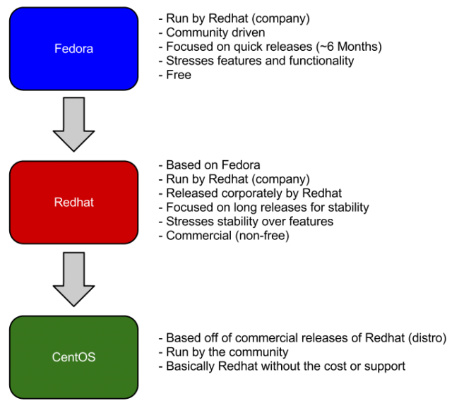


Fedora vs. Red Hat vs. CentOS
https://fedoraproject.org
https://www.redhat.com
https://www.centos.org

Slide 11
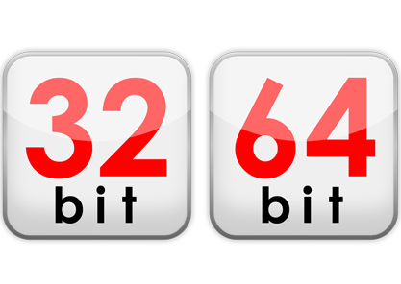
Operating System (OS) Architecture
32 bit OS – i386 (x86)
64 bit OS – x64 (x86_64)

Slide 12
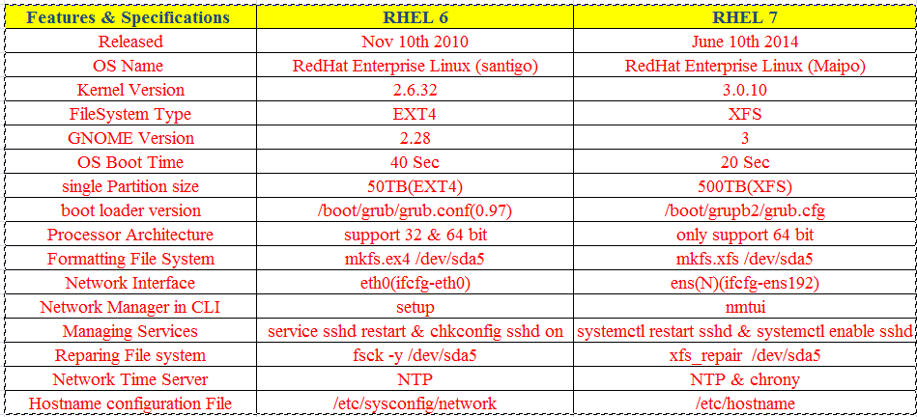
Difference Between RHEL 6 and RHEL 7

Slide 13
Thank you

